Slide 1
Introduction to Memory
Barbara Oakley, PhD, PE

Slide 2
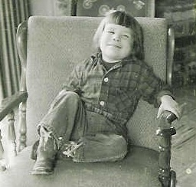
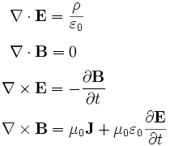
Здравствуйте

Slide 3
Long term memory
Working memory

Slide 4
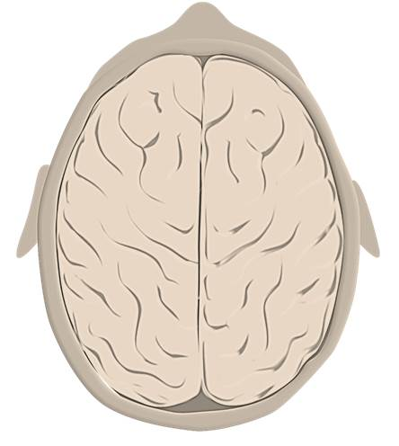
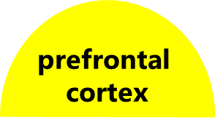




Slide 5

202-555-0178
202-555-0178 ?

Slide 6
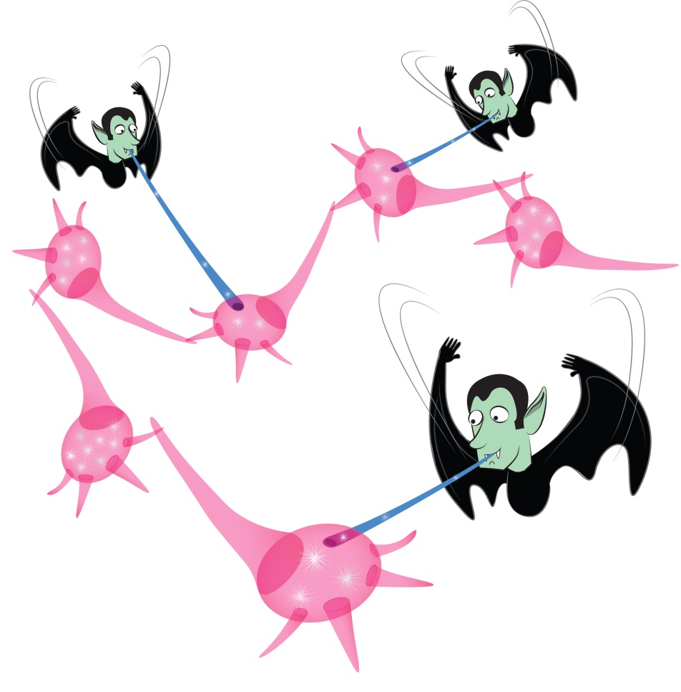

Slide 7



Four slots
Short term memory

Slide 8

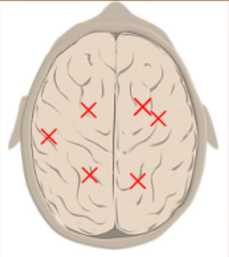
Long term memory

Slide 9
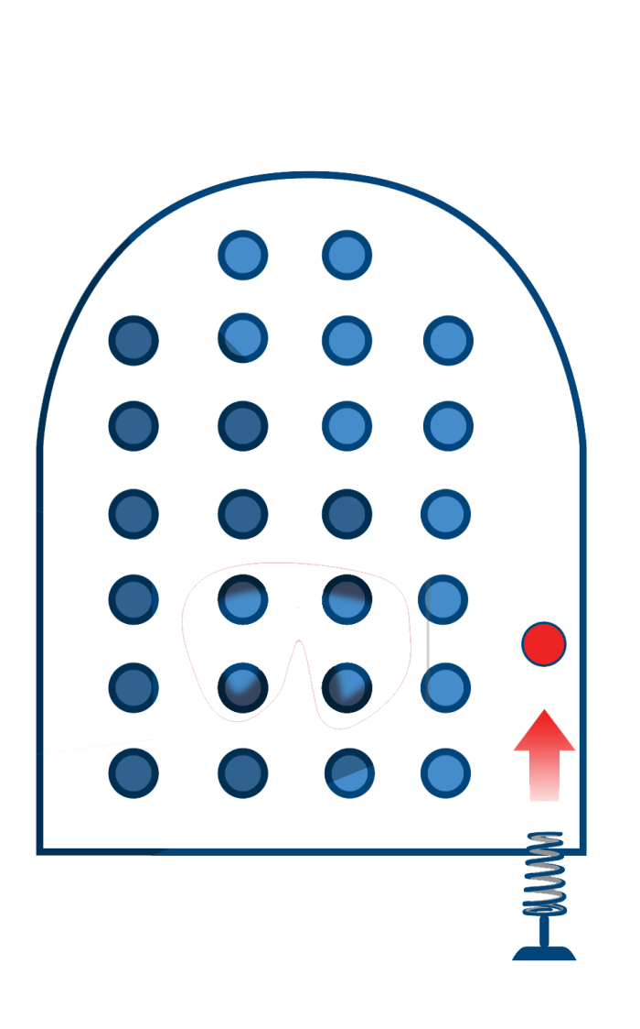
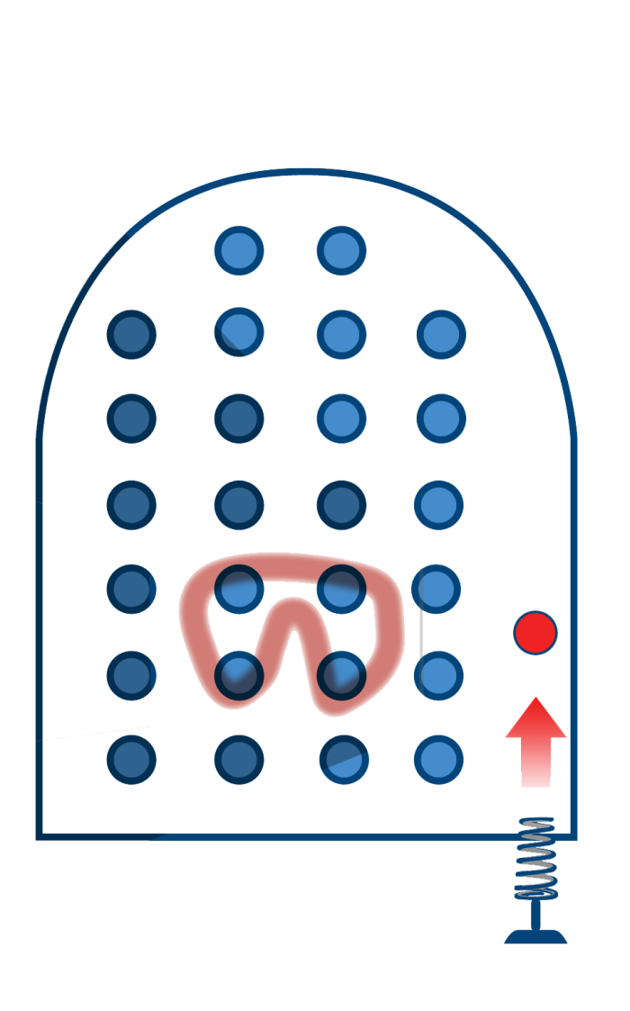
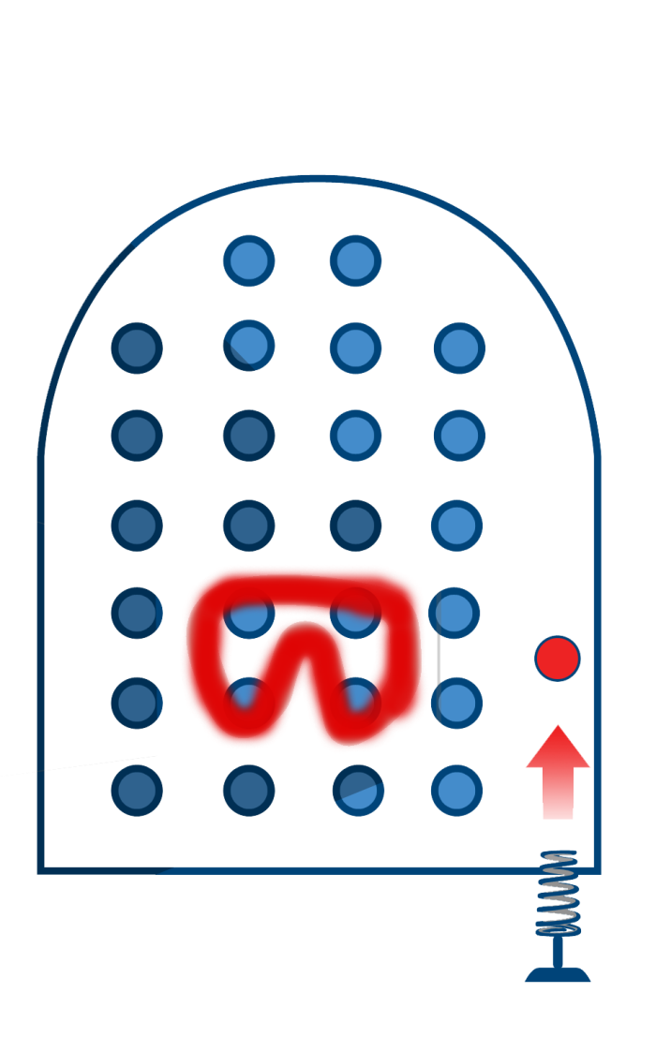

Slide 10
Working memory
Long term
memory

Slide 11

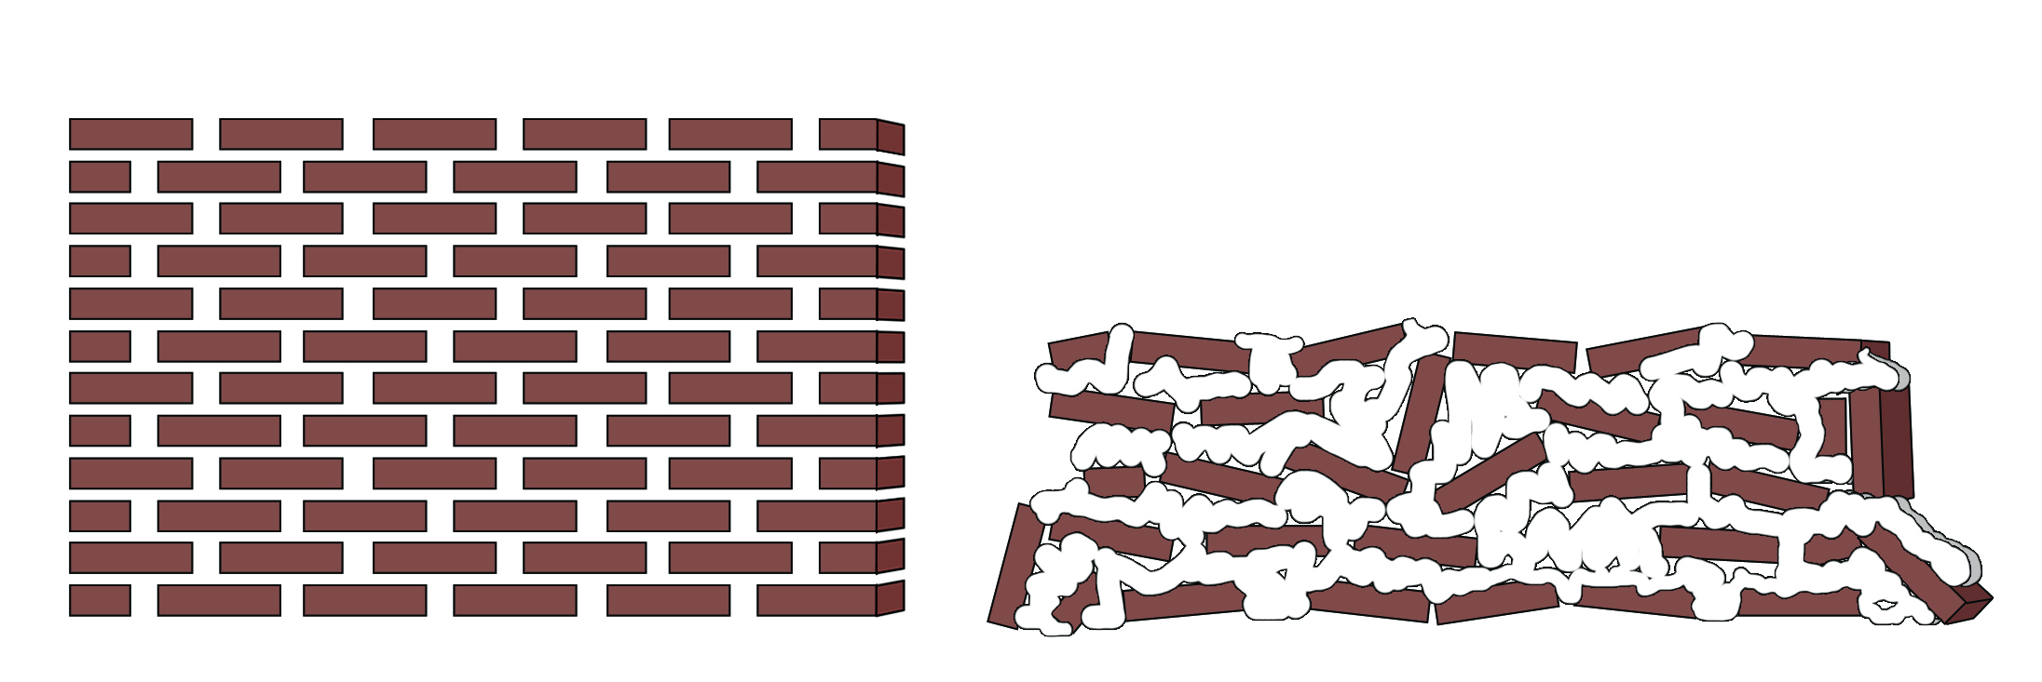
Monday | Tuesday | Wednesday | Thursday | Friday | Saturday | Sunday
Monday | Tuesday | Wednesday | Thursday | Friday | Saturday | Sunday

Slide 12
Recommended Reading
Baddeley, A., Eysenck, M. W., & Anderson, M. C. (2009). Memory. NY: Psychology Press.
Carpenter, S. K., Cepeda, N. J., Rohrer, D., Kang, S. H. K., & Pashler, H. (2012). Using spacing to enhance diverse forms of learning: Review of recent research and implications for instruction. Educational Psychology Review, 24(3), 369-378. doi: 10.1007/s10648-012-9205-z
Cowan, N. (2001). The magical number 4 in short-term memory: A reconsideration of mental storage capacity. Behavioral and Brain Sciences, 24(1), 87-114.
Dudai, Y. (2004). The neurobiology of consolidations, or, how stable is the engram? Annual Review of Psychology, 55, 51-86.
Dunlosky, J., Rawson, K. A., Marsh, E. J., Nathan, M. J., & Willingham, D. T. (2013). Improving students’ learning with effective learning techniques: Promising directions from cognitive and educational psychology. Psychological Science in the Public Interest, 14(1), 4-58.
Guida, A., Gobet, F., Tardieu, H., & Nicolas, S. (2012). How chunks, long-term working memory and templates offer a cognitive explanation for neuroimaging data on expertise acquisition: A two-stage framework. Brain and Cognition, 79(3), 221-244. doi: 10.1016/j.bandc.2012.01.010
Rawson, K. A., & Dunlosky, J. (2011). Optimizing schedules of retrieval practice for durable and efficient learning: How much is enough? Journal of Experimental Psychology: General, 140(3), 283.
Rohrer, Doug, Robert F. Dedrick, and Kaleena Burgess. "The Benefit of Interleaved Mathematics Practice Is Not Limited to Superficially Similar Kinds of Problems." Psychonomic Bulletin & Review in press (2013).
Rohrer, D., & Pashler, H. (2010). Recent research on human learning challenges conventional instructional strategies. Educational Researcher, 39(5), 406-412.

Slide 13
Illustration credits
Barbara Oakley, age 3, looking happy as the proverbial clam.
Brain cross-section, ©Kevin Mendez, 2014.
Metabolic vampires, ©Kevin Mendez, 2014.
Pinball metaphor, ©Kevin Mendez, 2014.
Brick walls, ©Kevin Mendez, 2014.
Clip art courtesy Microsoft Corporation.

